Slide 1

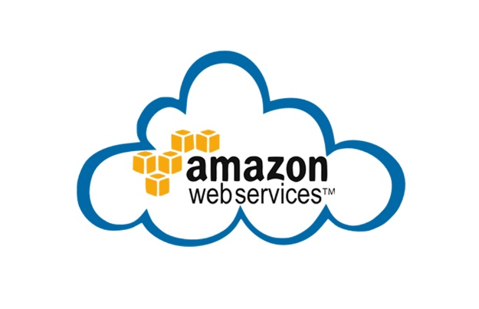
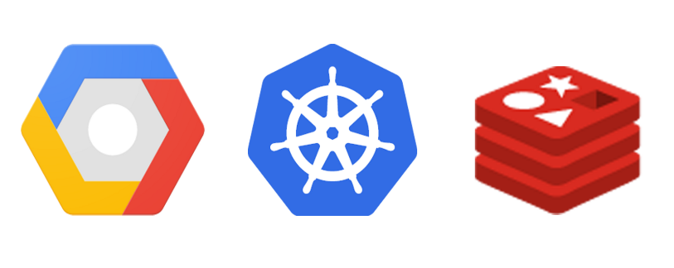

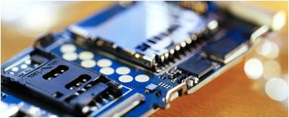

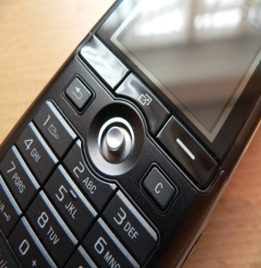



CLOUD COMPUTING
101
BAO HUYNH (LDE)
09/09/2018

Slide 2
AGENDA
‘CLOUD’ WHAT ?
CLOUD COMPUTING, WHY ?
CLOUD DEPLOYMENT MODEL
CLOUD SERVICE MODEL
‘CLOUDINIZATION’, HOW ?
AWS & SERVICES

Slide 3
AGENDA
‘CLOUD’ WHAT ?
CLOUD COMPUTING, WHY ?
CLOUD DEPLOYMENT MODEL
CLOUD SERVICE MODEL
‘CLOUDINIZATION’, HOW ?
AWS & SERVICES

Slide 4






















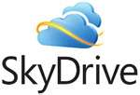


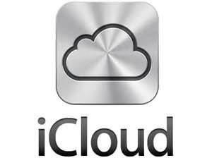









I.‘CLOUD’ WHAT ?
Notes:
Take the poll
Have you used the cloud
For one, two, three, or more of these services

Slide 5
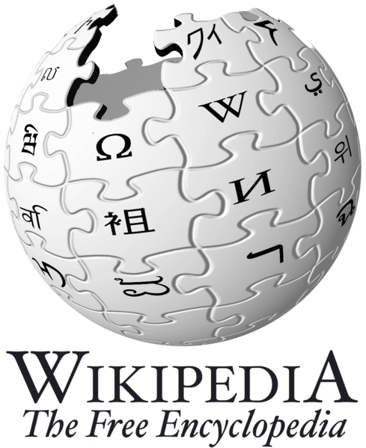
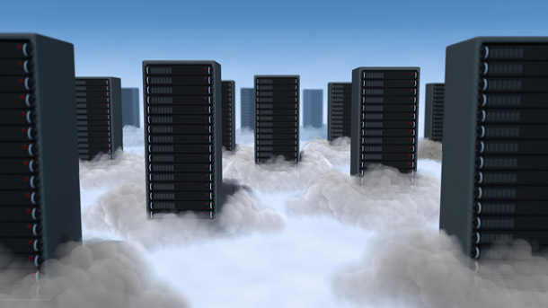
I.‘CLOUD’ WHAT ?
Definition from Wikipedia
Cloud computing is Internet-based computing, whereby shared resources, software, and information are provided to computers and other devices on demand, like the electricity grid.
Cloud computing is a style of computing in which dynamically scalable and often virtualized resources are provided as a service over the Internet.
What is
“cloud computing” ?

Slide 6
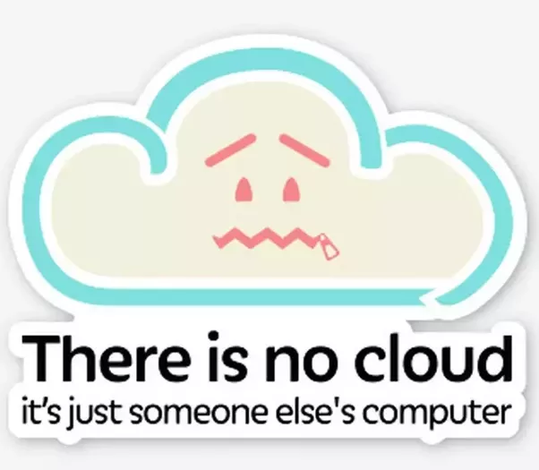
I.‘CLOUD’ WHAT ?
So, “CLOUD” where are you ?
SERVERLESS

Slide 7
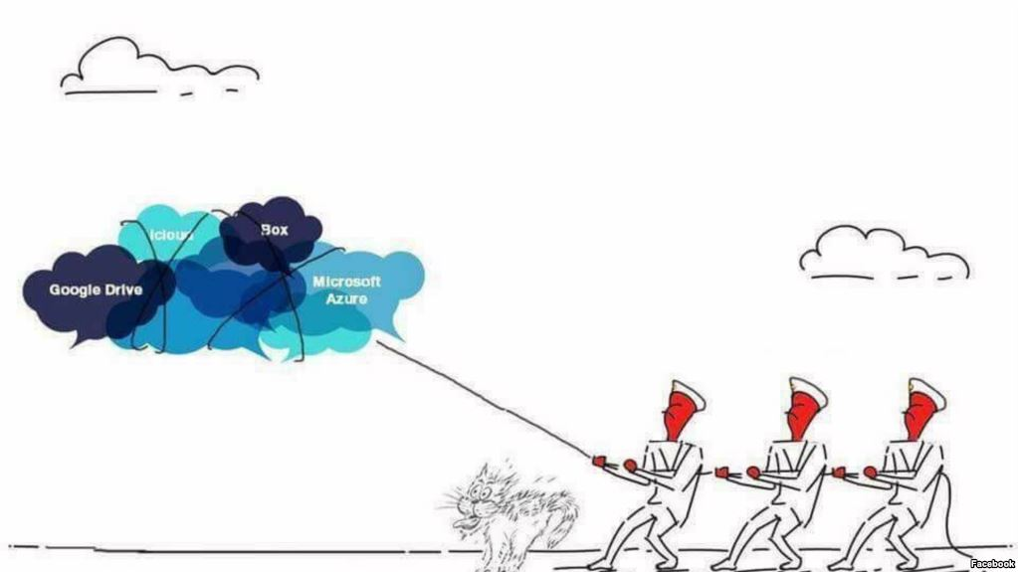

I.‘CLOUD’ WHAT ?
GU-GỜ, PÊ-TÊ BỐK
GU-GỜ, PÊ-TÊ BỐK

Slide 8
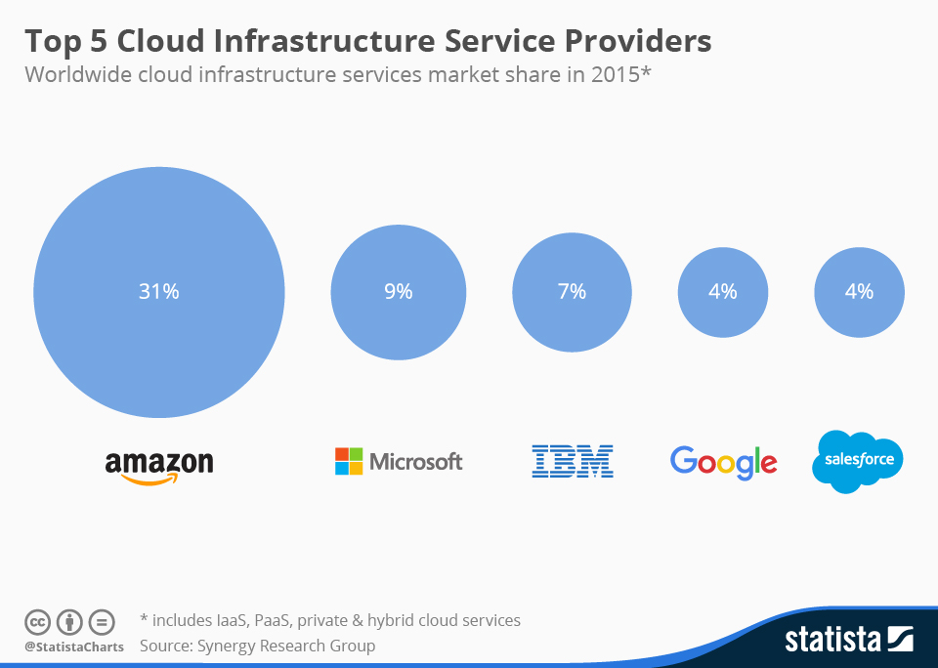
I.‘CLOUD’ WHAT ?

Slide 9
AGENDA
‘CLOUD’ WHAT ?
CLOUD COMPUTING, WHY ?
CLOUD DEPLOYMENT MODEL
CLOUD SERVICE MODEL
‘CLOUDINIZATION’, HOW ?
AWS & SERVICES

Slide 10
CLOUD COMPUTING, WHY ? (1/2)
SCALABILITY & ELASTICITY (no HW limitation)
WHY CLOUD

Slide 11

Scalability & Elasticity
Give me the world without limitation!!

Slide 12
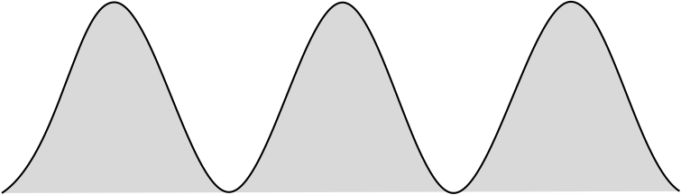
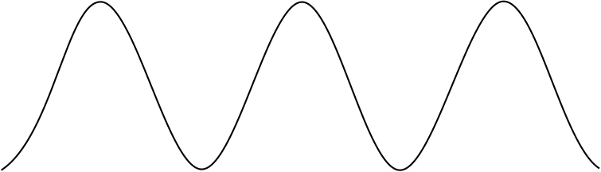
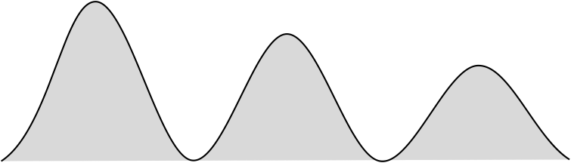

Scalability & Elasticity
In traditional computing model, two common problems :
Underestimate system utilization which result in under provision
Loss Revenue
Resources
Capacity
Resources
Demand
Capacity
1
2
3
Demand
Loss Users
2
3
Resources
Capacity
1
Time (days)
Demand
1
2
3

Slide 13
Scalability & Elasticity
Overestimate system utilization which result in low utilization
How to solve this problem ??
Dynamically provision resources
Capacity
Resources
Unused resources
Demand
Time

Slide 14
Scalability & Elasticity
Provisioned cloud resource dynamically
Meet demand variations between different industries
Meet burst demand for some extraordinary events
Resources
Capacity
Resources
Capacity
Demand
Demand
Time
Time

Slide 15
CLOUD COMPUTING, WHY ? (2/4)
SCALABILITY & ELASTICITY (no HW limitation)
WHY CLOUD
HIGH AVAILABILITY & RELIABILITY

Slide 16

Availability & Reliability
Data Never Loss Machine Never Down

Slide 17
Availability & Reliability
Availability
AWS S3 database with 99.999% availability
AWS EC2 Data volume is replicated automatically among Availability Zones within region.
→ Key to achieve “Reliability” (functional 24/7)
How to achieve
Fault tolerance system
Disaster Recovery
System security (IAM, Firewall, ACL, Security Group, LDAP, Fail2ban,..)

Slide 18

Fault Tolerance
Avoid Single Point Of Failure (SPOF)
SPOF stop the entire system from working !!!

Slide 19

Fault Tolerance
Fault Detection and Isolation (FDI)
Monitoring system
Healcheck mechanism
Isolate failing component
- Traffic won’t be routed to
unhealthy component
until they are back Ex: Nginx, Kubernetes,…

Slide 20
Fault Tolerance
Fault Containment
Some failure mechanisms can cause a system to fail by propagating the failure to the rest of the system.
Mechanisms that isolate a rogue transmitter or failing component to protect the system are required.
Available of reversion modes
System should be able to maintain some check points which can be used in managing the state changes.

Slide 21
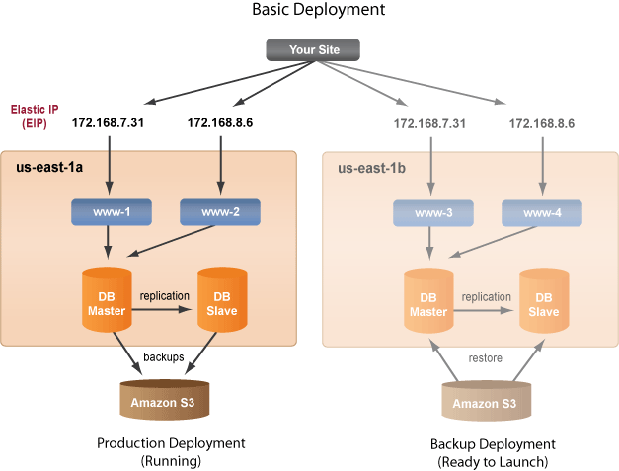
Fault Tolerance & Disaster Recovery (v1)

Slide 22
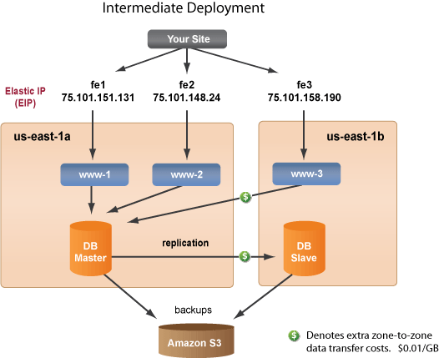
Fault Tolerance & Disaster Recovery (v2)

Slide 23
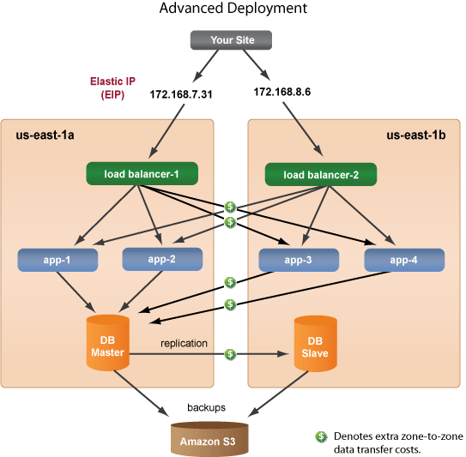
Fault Tolerance & Disaster Recovery (v3)

Slide 24
CLOUD COMPUTING, WHY ? (3/4)
SCALABILITY & ELASTICITY (no HW limitation)
GLOBAL ACCESSIBILITY
WHY CLOUD
HIGH AVAILABILITY & RELIABILITY

Slide 25

Global Accessibility
Anyone !
Anytime !
Anywhere !

Slide 26

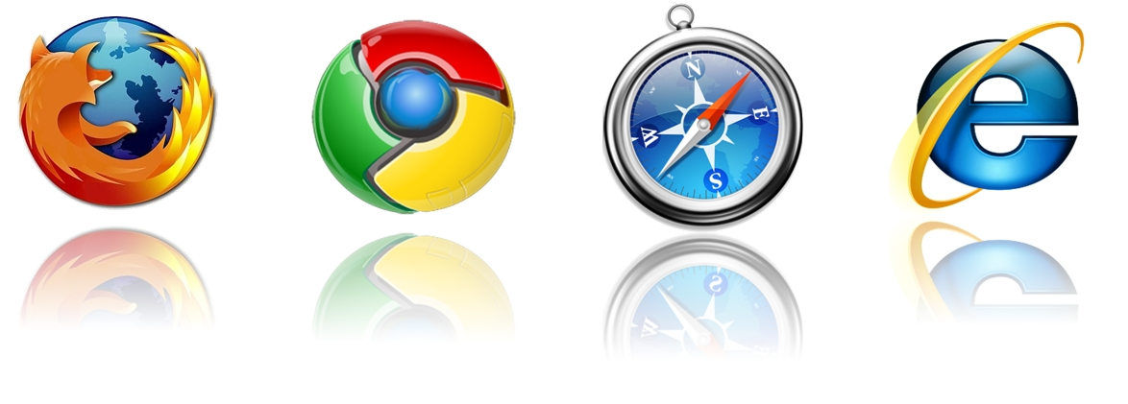
Global Accessibility

Slide 27
CLOUD COMPUTING, WHY ? (4/4)
SCALABILITY & ELASTICITY (no HW limitation)
GLOBAL ACCESSIBILITY
WHY CLOUD
LESS COST & EFFORT FOR HW MANAGEMENT
HIGH AVAILABILITY & RELIABILITY

Slide 28
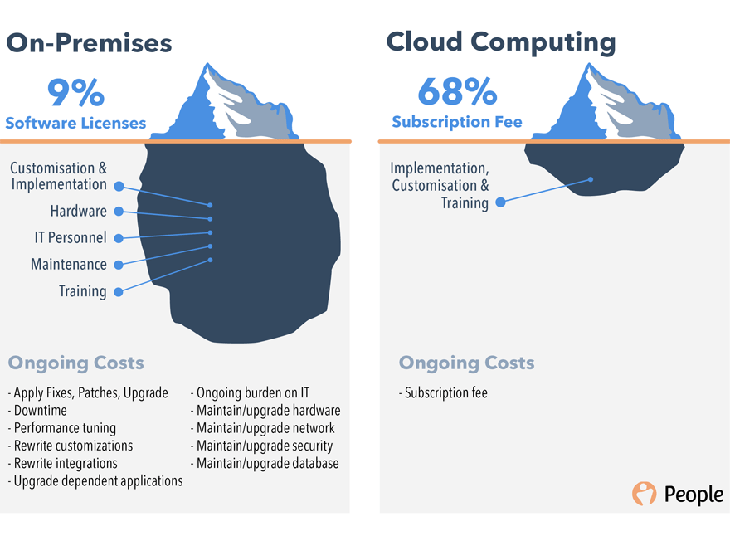
Less cost for HW management

Slide 29
CLOUD COMPUTING, WHY ? (4/4)
SCALABILITY & ELASTICITY (no HW limitation)
GLOBAL ACCESSIBILITY
WHY CLOUD
LESS COST & EFFORT FOR HW MANAGEMENT
HIGH AVAILABILITY & RELIABILITY

Slide 30
AGENDA
‘CLOUD’ WHAT ?
CLOUD COMPUTING, WHY ?
CLOUD DEPLOYMENT MODEL
CLOUD SERVICE MODEL
‘CLOUDINIZATION’, HOW ?
AWS & SERVICES

Slide 31
III. DEPLOYMENT MODEL (1/5)
There are four primary cloud deployment models :
Public Cloud
Private Cloud
Community Cloud
Hybrid Cloud
Each can exhibit the previously discussed characteristics; their differences lie primarily in the scope and access of published cloud services, as they are made available to service consumers.

Slide 32
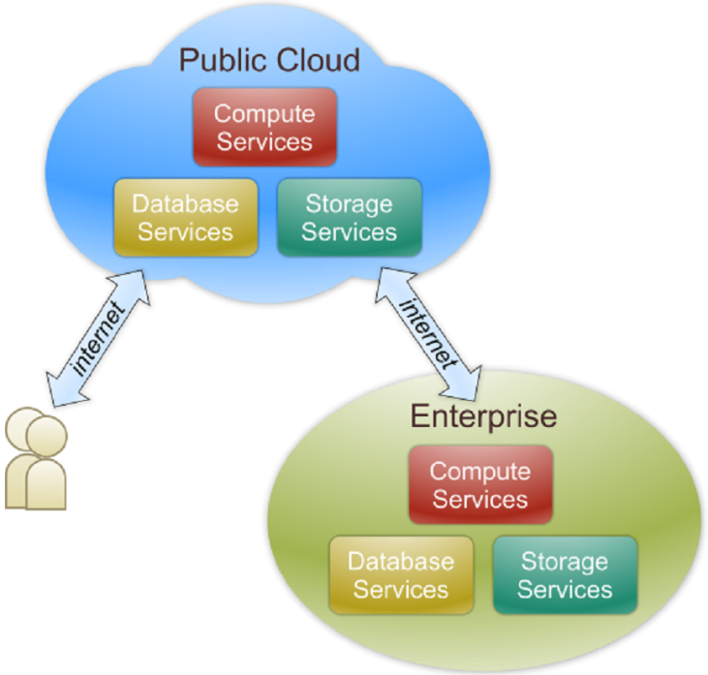
III. DEPLOYMENT MODEL (2/5)
(Public Cloud)
Public cloud
The cloud infrastructure is made available to the general public or a large industry group and is owned by an organization selling cloud services.

Slide 33
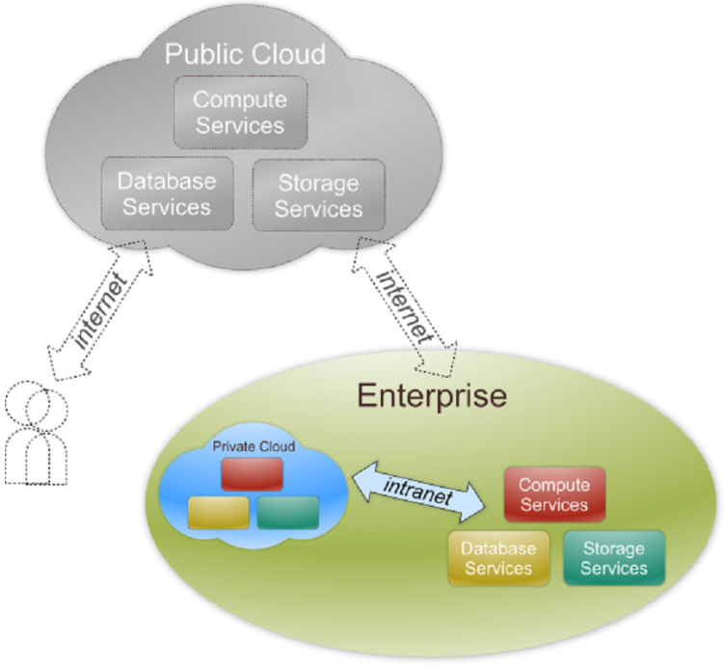
III. DEPLOYMENT MODEL (3/5)
(Private Cloud)
Private cloud definition
The cloud infrastructure is operated solely for an organization. It may be managed by that organization or a third party and may exist on premise or off premise.

Slide 34
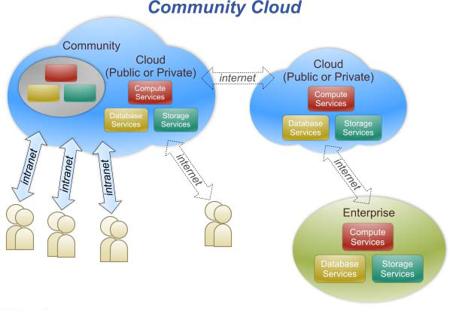
III. DEPLOYMENT MODEL (4/5)
(Community Cloud)
Community cloud definition
The cloud infrastructure is shared by several organizations and supports a specific community that has shared concerns

Slide 35
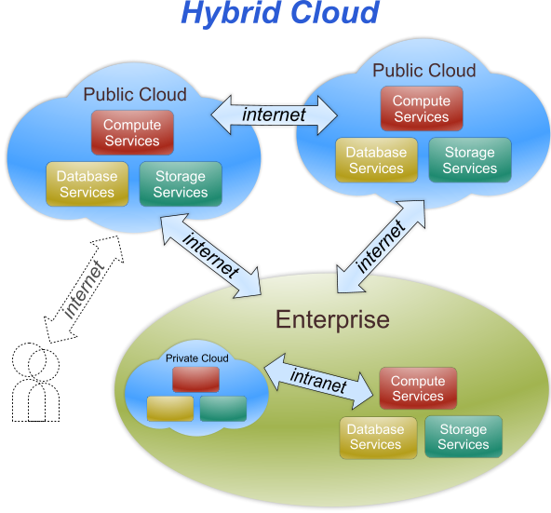
III. DEPLOYMENT MODEL (5/5)
(Hybrid Cloud)
Hybrid cloud definition
The cloud infrastructure is a composition of two or more clouds (private & community/public)

Slide 36
AGENDA
‘CLOUD’ WHAT ?
CLOUD COMPUTING, WHY ?
CLOUD DEPLOYMENT MODEL
CLOUD SERVICE MODEL
‘CLOUDINIZATION’, HOW ?
AWS & SERVICES

Slide 37

III. DEPLOYMENT MODEL
SIMPLE ANOLOGY
Say, you just moved
to a city & looking
for a place to live

Slide 38

III. DEPLOYMENT MODEL
What is your choice ?
Built a new house
Buy an empty house
Live in a hotel

Slide 39
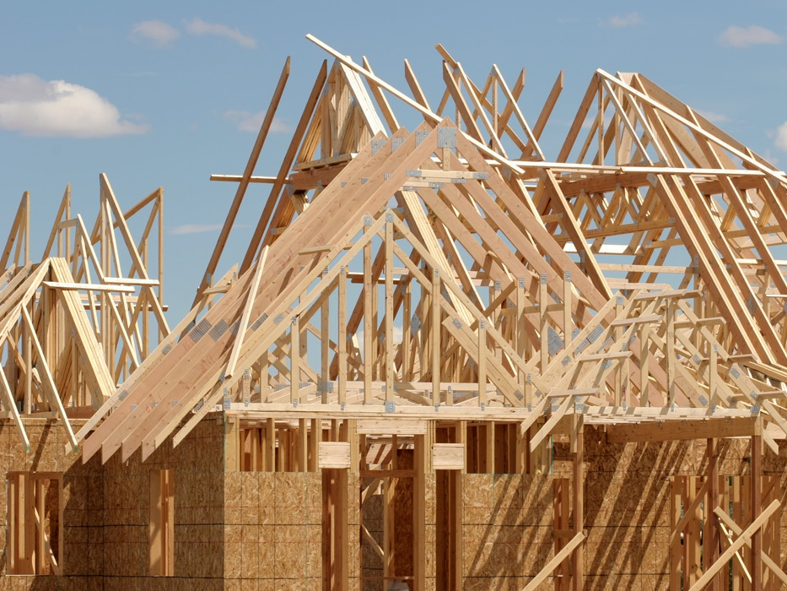
Let’s build a new house !
You can fully control everything your like your new house to have.
But that is a really really tough work …

Slide 40

If you buy an empty house ?
Can customize some part of your house.
But never change the original architecture.

Slide 41

How about live in hotel ?
- The only thing you care is enjoy !!
- Nothing else to deal with builiding

Slide 42

Let’s translate to Cloud Computing
language !!

Slide 43
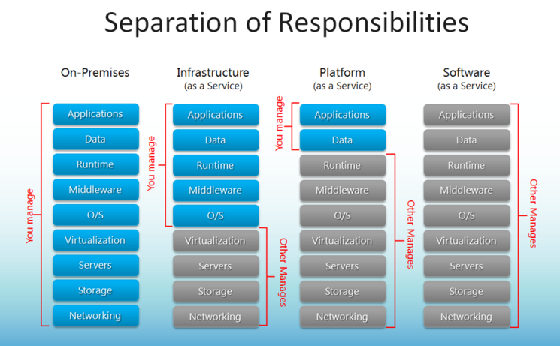
III. CLOUD SERVICE MODEL
BUILD NEW HOSE
BUY EMPTY HOUSE
LIVE IN HOTEL

Slide 44
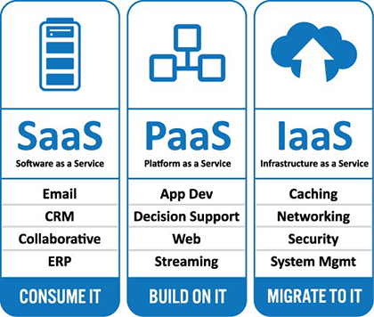
III. CLOUD SERVICE MODEL

Slide 45
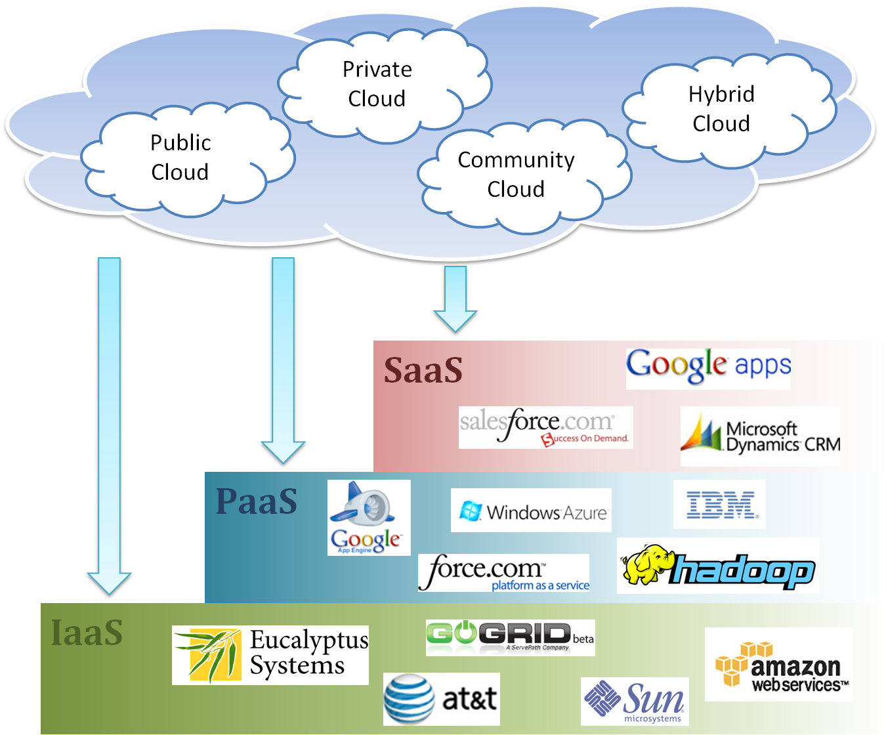
Cloud Ecosystem

Slide 46

NO MORE, PLEASE
It’s too much !

Slide 47
AGENDA
‘CLOUD’ WHAT ?
CLOUD COMPUTING, WHY ?
CLOUD DEPLOYMENT MODEL
CLOUD SERVICE MODEL
CLOUDINIZATION’, HOW ?
AWS & SERVICES

Slide 48
V. CLOUDINIZATION, HOW ? (1/2)
CLOUD RESOURCE MANAGEMENT
Openstack
MICROSERVICE ARCHITECHTURE
Docker
CONTAINER ORCHESTRATION
Kubernetes
CONFIGURATION/ORCHESTRATION TOOL
Ansible/Puppet/Salt/…
Terraform/Terragrunt.
MONITORING & ALERT
Nagios, Icinga2, Prometheus,…

Slide 49
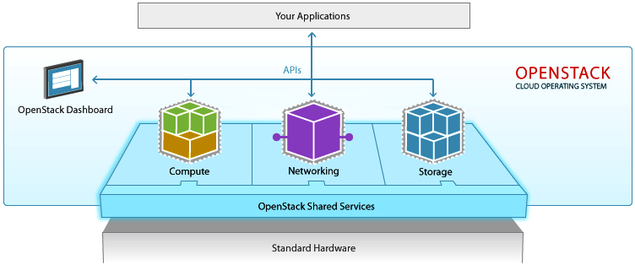
V. CLOUDINIZATION, HOW ? (2/2)
Container deployment/Orchestration (KUBERNETES)
Backend
database
Frontend
web
Storage/backup
service
Virtual resources/ configuration manage (Terraform/Puppet)
VIRTUAL HW ABSTRACTION

Slide 50
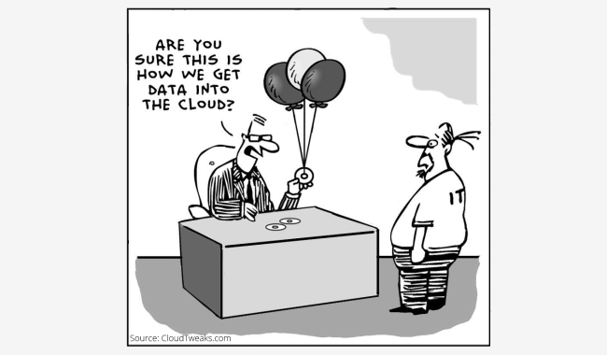
V. CLOUDINIZATION, HOW ?

Slide 51
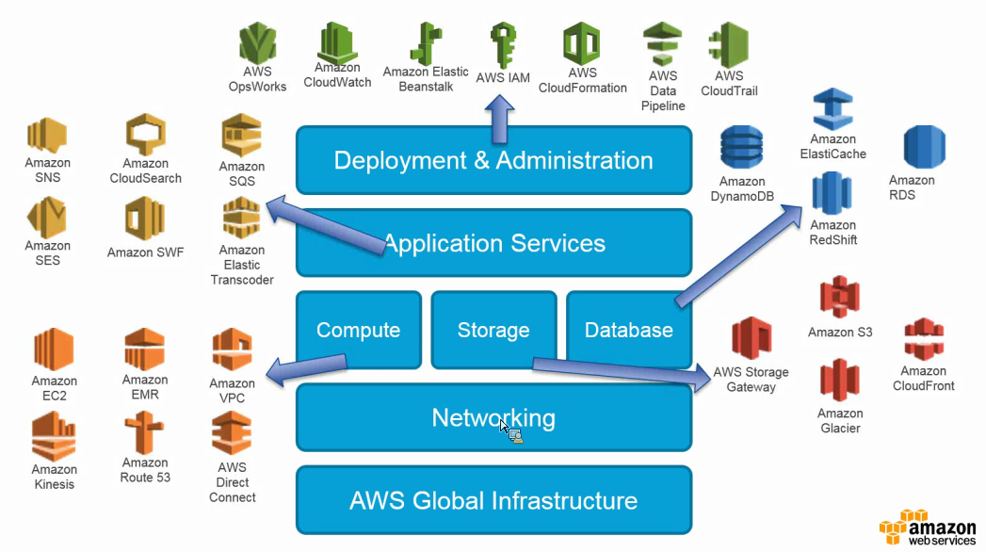
VI. AWS & SERVICES

Slide 52
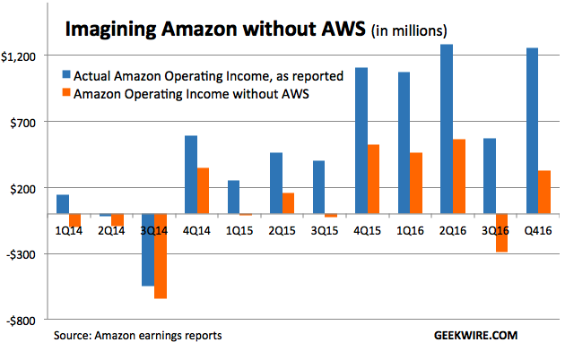
VI. AWS & SERVICES

Slide 53
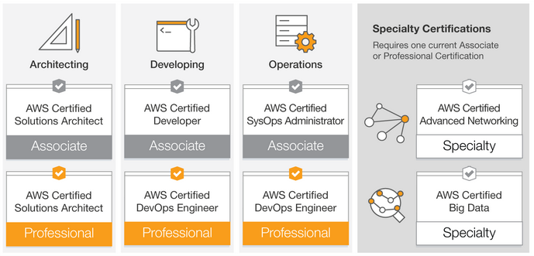
VI. AWS & SERVICES
> 150 000$/Year (US Market)
AWS CERITIFICATE ROADMAP

Slide 54
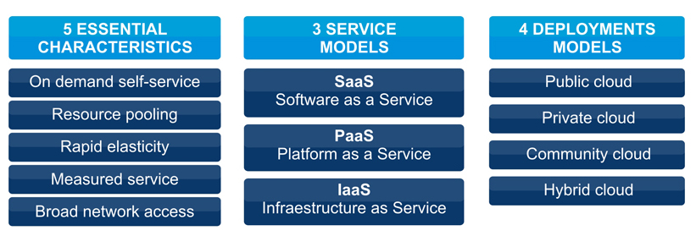
SUMMARY

Slide 55
